Slide 1
Baseline Model——Market Following Strategy
market following strategy
market maker quotes at the same as market price after reaction time X.
constrains:
Loss Limit(L)
max net position(K)
Cost to hedge our position(k)
fit orders

Slide 2
Baseline Model——Market Following Strategy
see this strategy for a buy order
net_pos_temp<=-K:
max open position triggered
net_pos_temp>-K
market price for the order>market maker quotation:
sell better than M price
market price for the order=market maker quotation
market price for the order<market maker quotation:
worse than market price
random seed>0.5:
sell at M price and succeed
otherwise:sell at M price but failed

Slide 3
Baseline Model——Market Following Strategy
How reaction time X will influence our strategy.
No max loss limit.
No net position limit.

Slide 4
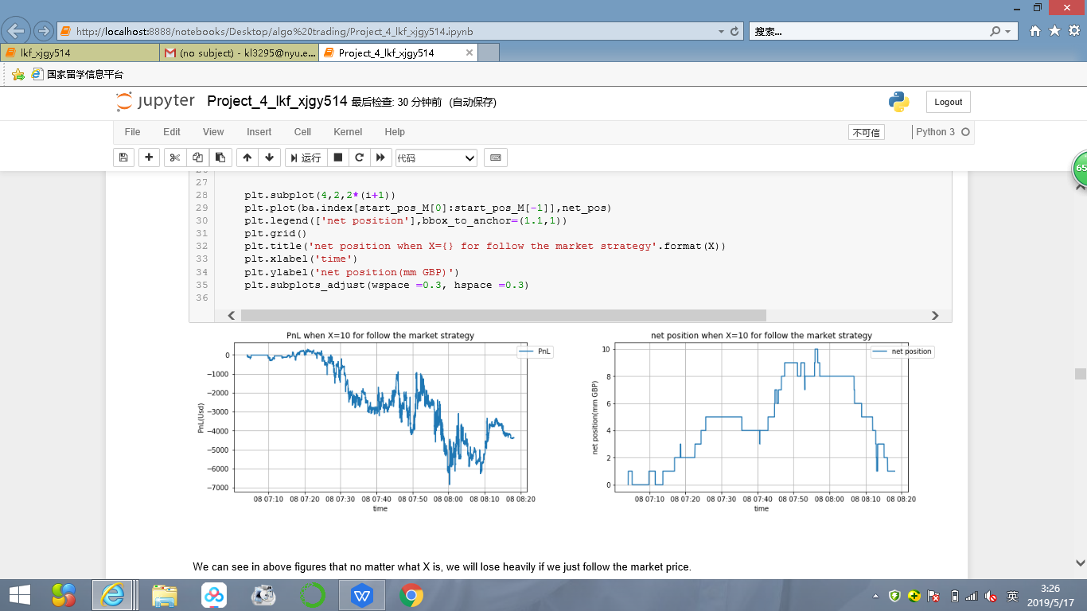
Baseline Model——Market Following Strategy
order set 1——in a relatively stable market
Let's see how X will influence PnL and net position for this market following strategy in next slide.

Slide 5
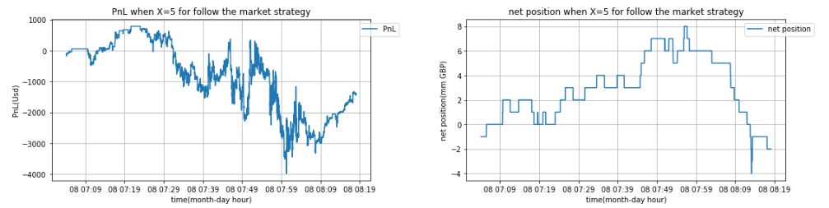
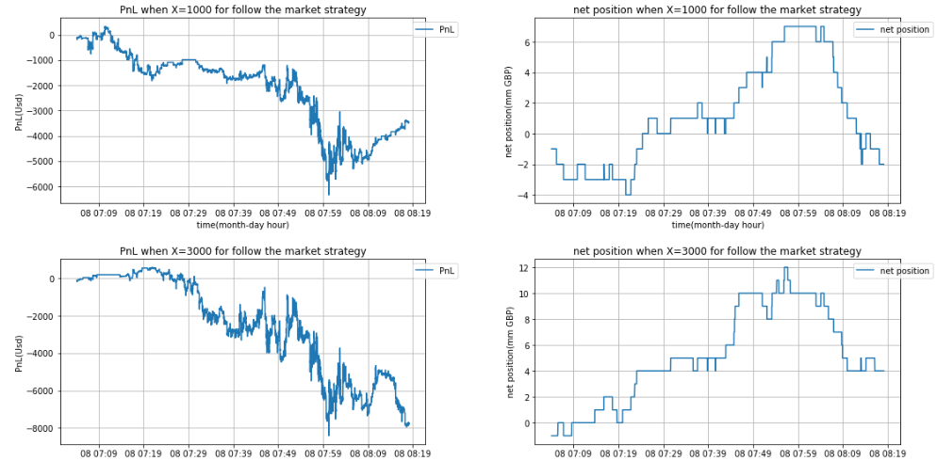
Baseline Model——Market Following Strategy
order set 1——in a realatively stable market
The figures show PnL and net position when X=5msec, 1000 msec and 3000 msec respectively.
We can see that changing of reaction time X doesn't influence a lot because this is a relatively stable market.

Slide 6
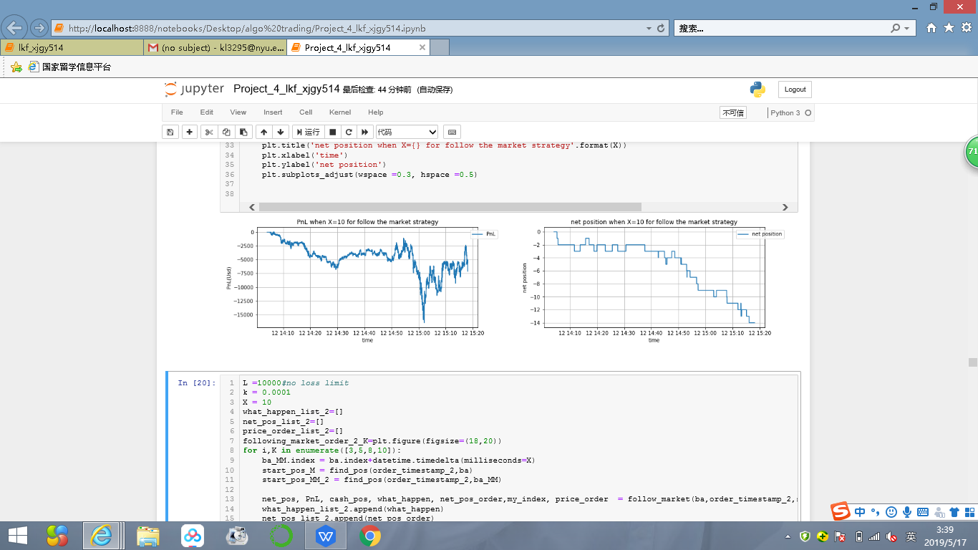
Baseline Model——Market Following Strategy
order set 2——in an uptrend market
Let's see how reaction ttime:X will influence PnL and net position for this market following strategy in next slide.

Slide 7
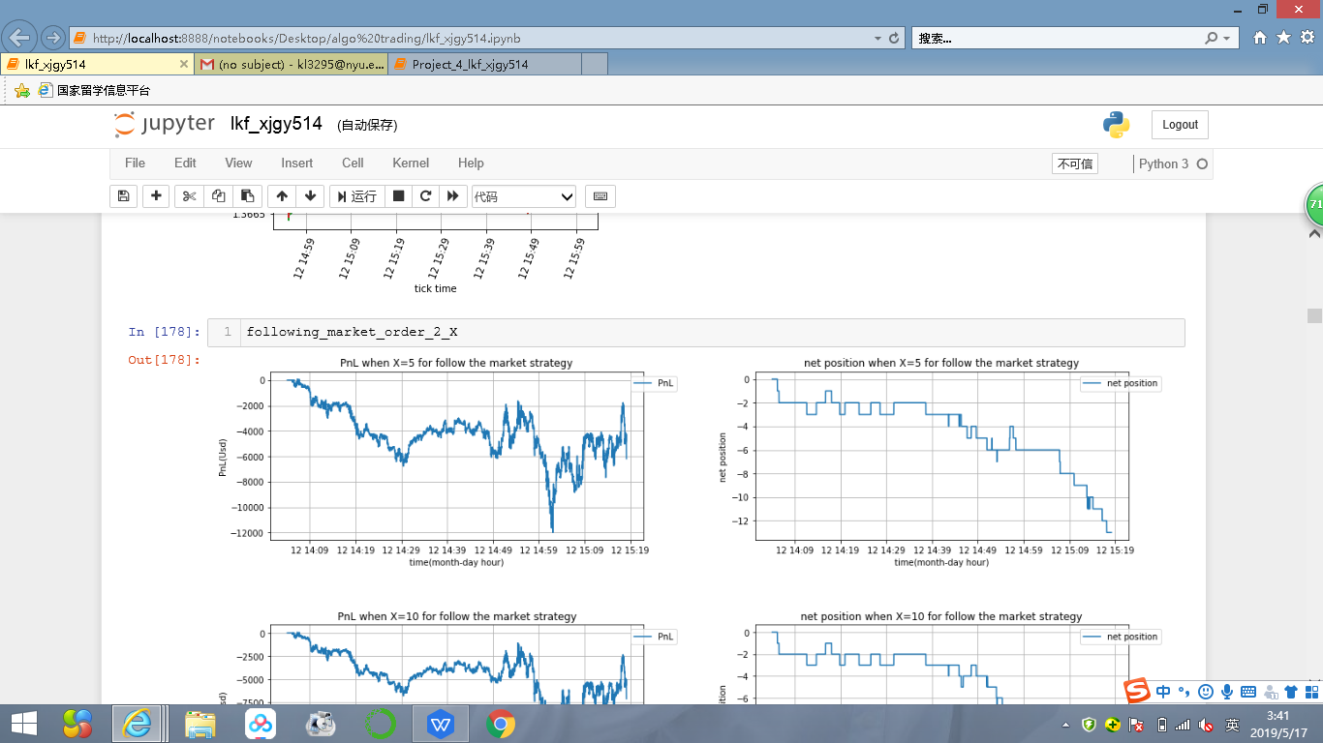
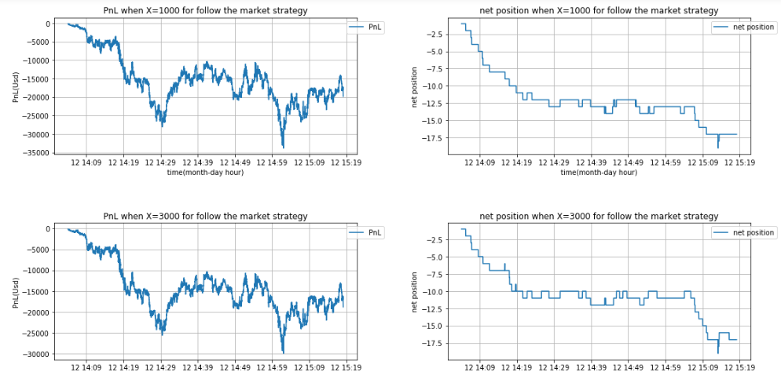
Baseline Model——Market Following Strategy
order set 2——in an uptrend market
The figures show PnL and net position when X=5msec, 1000 msec and 3000 msec respectively.
We can see that changing of reaction time X influences net position a lot because this is an uptrend market and more buy orders will be executed after reaction time.

Slide 8
Baseline Model——Market Following Strategy
How net position limit K will influence our strategy.
Set reaction time X=10msec.
No max loss limit.

Slide 9
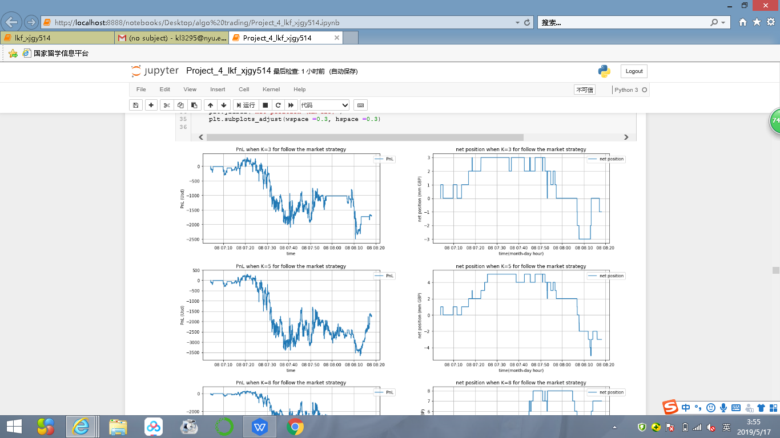
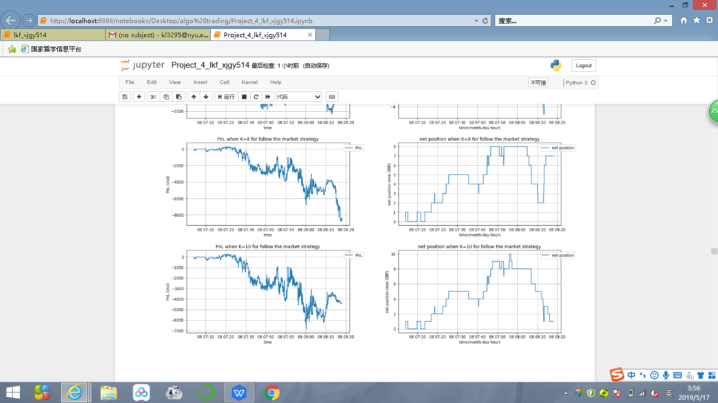
Baseline Model——Market Following Strategy
order set 1——in a relatively stable market
How K=3mm, 5mm, 8mm, 10mm will influence PnL and net position for this market following strategy.

Slide 10
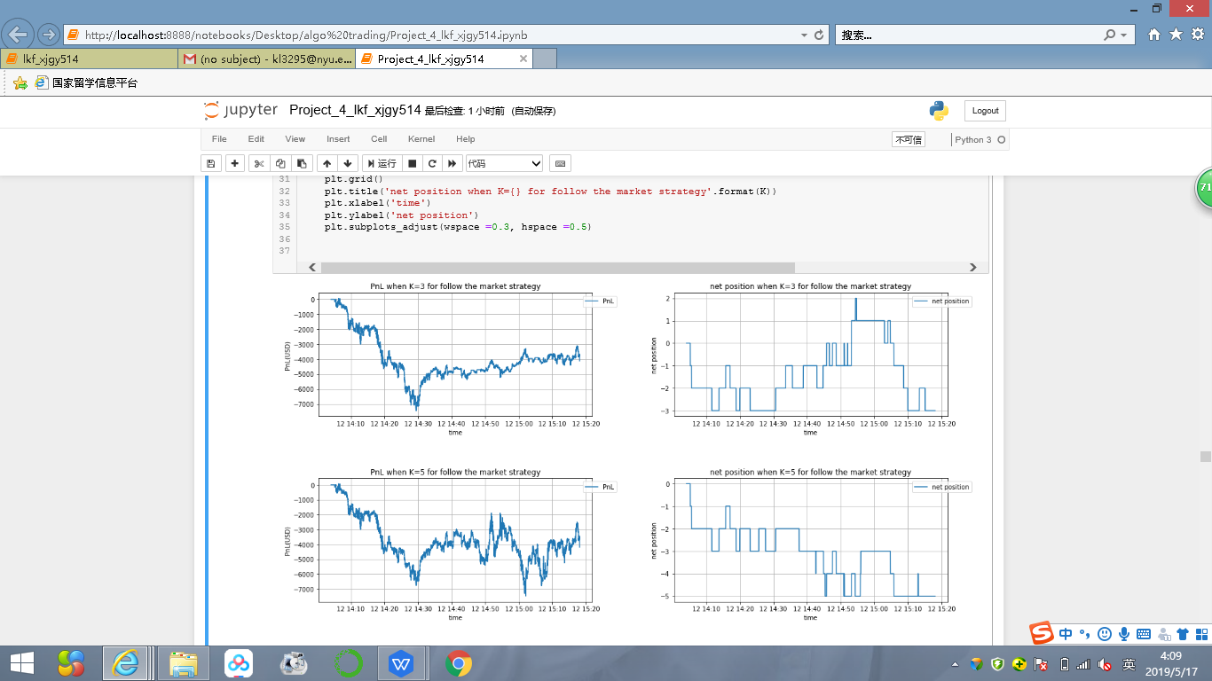
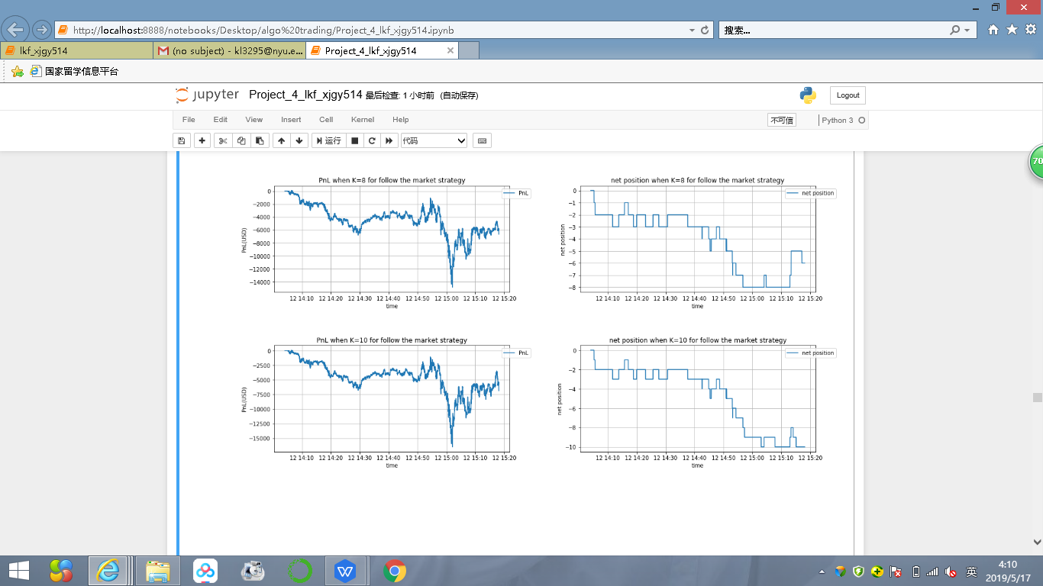
Baseline Model——Market Following Strategy
order set 2——in an uptrend market
How K=3mm, 5mm, 8mm, 10mm will influence PnL and net position for this market following strategy.

Slide 11
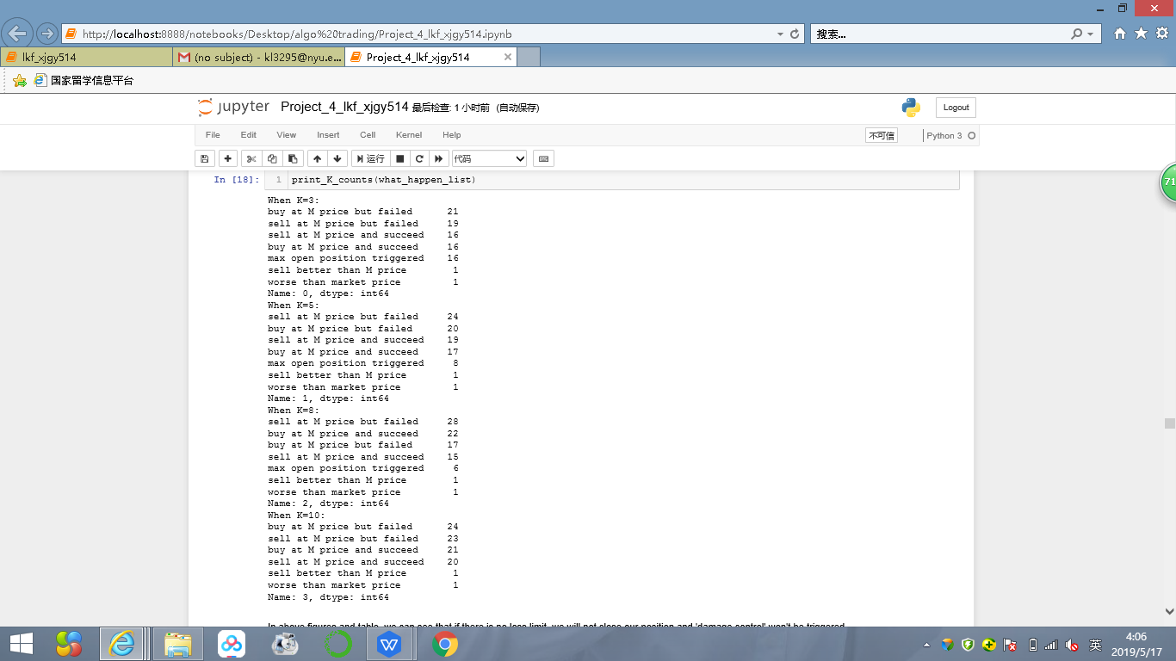
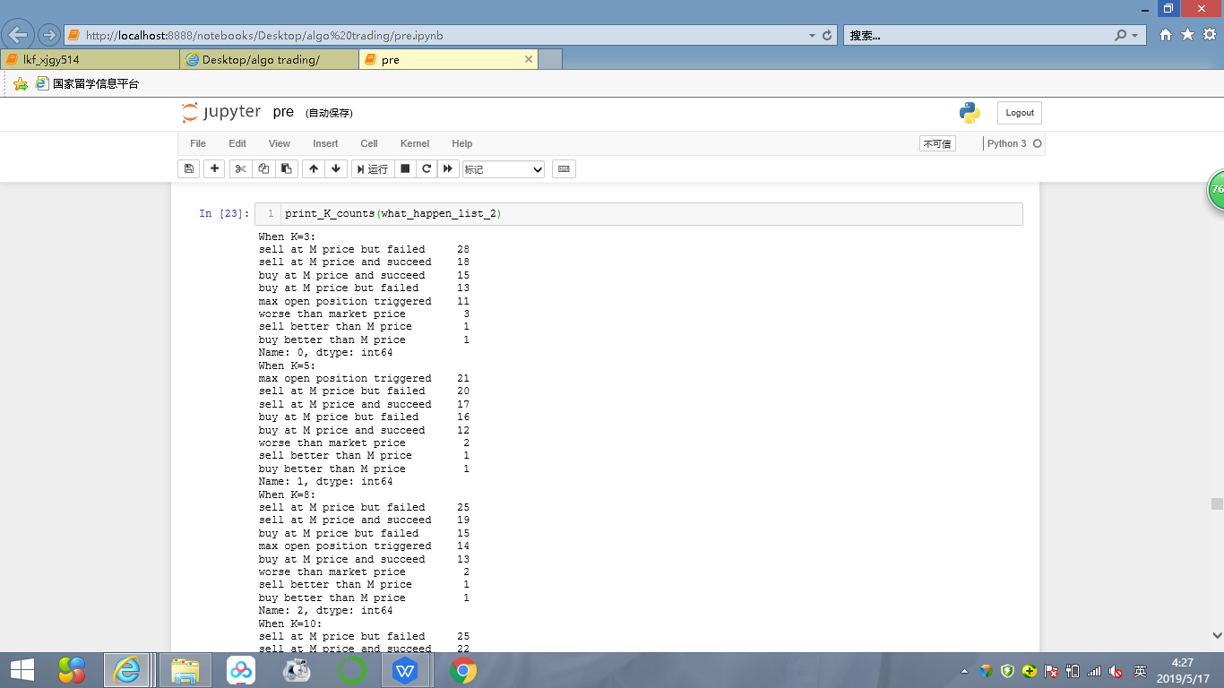
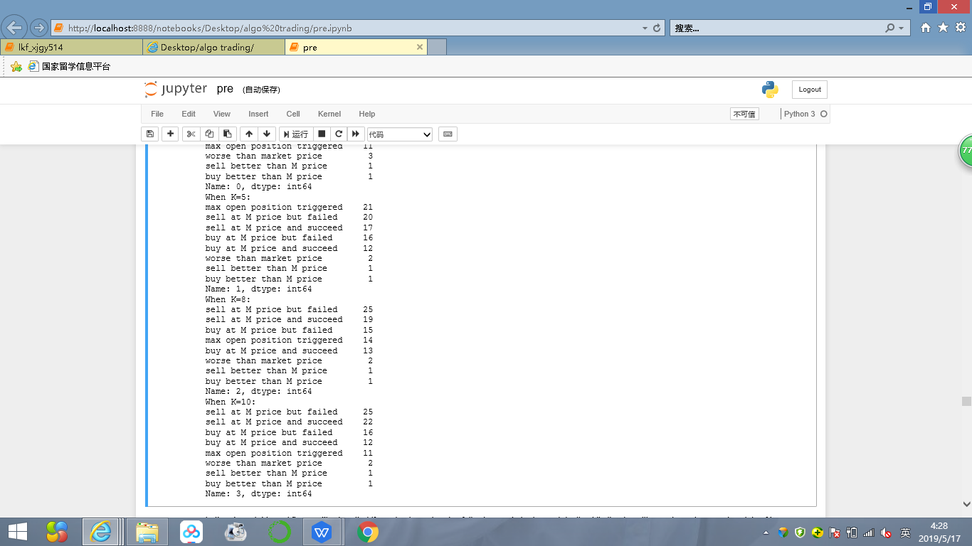
Baseline Model——Market Following Strategy
order set 1——in a realatively stable market
order set 2——in an uptrend market
We can see that when K is bigger, max open position triggered appears more in uptrend market.

Slide 12
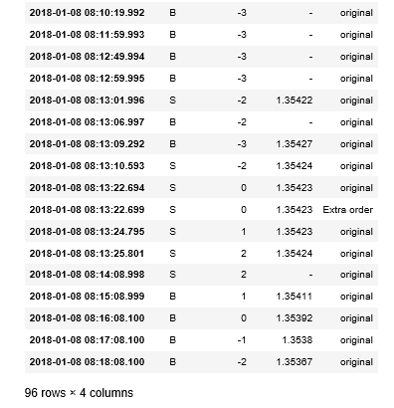
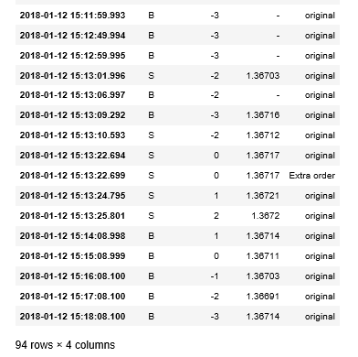
Part of delivery table
order set 1——in a realatively stable market
order set 2——in an uptrend market

Slide 13
Conclusion
Follow-Market startegy performs fine in stable market, but suffers net position explosion in uptrend or downtrend market.
To some degree, Dynamic-Adjust strategy performs better in uptrend or downtrend market. However, it can't stand extremely biased orders set in a short period of time( all buy orders given in one minute we already has a negative net position.)
To sum up, Dynamic-Adjust strategy is a good improvement based on Follow-Market Strategy.

Slide 14
project team members:
Jiangguangyu Xue
Kefei Liu
THANKS!
05/17/2019

